Slide 1
SITUATIONAL REPORT
ST. JOSEPH’s HOSPITAL, JIRAPA
First quarter 2023

Slide 2
UPDATE ON health information
PERIOD UNDER REVIEW january 2022 – december 2022

Slide 3
OPD Attendance

Slide 4
Top 10 OPD Morbidity for 2022

Slide 5
Bed state Utilization
Indicator | 2016 | 2017 | 2018 | 2019 | 2020 | 2021 | 2022
Beds | 193 | 193 | 206 | 206 | 206 | 188 | 188
Admissions | 14,832 | 13,261 | 11,324 | 11,479 | 9,203 | 11,700 | 10,064
Discharges | 14,482 | 12,946 | 11,078 | 11,149 | 8,951 | 11,301 | 9,883
Death | 342 | 292 | 203 | 281 | 192 | 200 | 190
Death Rate | 2.3 | 2.2 | 1.8 | 2.4 | 2.1 | 1.7 | 1.9
Avg. Length of Stay | 4 | 4 | 3.3 | 3.6 | 3.7 | 3.2 | 3.1
Avg. Daily Occupancy | 143 | 130 | 102 | 113 | 93 | 100 | 86
%Occupancy | 73.9 | 67.3 | 49.5 | 55.1 | 44.9 | 53.3 | 45.9

Slide 6
Surgeries

Slide 7
Laboratory Services
SELECTED INDICATORS | 2018 | 2019 | 2020 | 2021 | 2022
TOTAL patients Seen | 30,574 | 34,402 | 22,168 | 24,424 | 28,747
Total Test Done | 130,704 | 153,182 | 111,246 | 104,539 | 127,588
Average test per client | 4 | 4 | 5 | 4 | 4.4
TRANSFUSION SERVICES
Total Transfusions | 1758 | 1,698 | 1,628 | 1,847 | 1,319
No of Children | 642 | 608 | 566 | 464 | 286
No of Adults | 1116 | 1,090 | 1,062 | 1,383 | 1,033
No of Donors Screened | 1,405 | 1,414 | 1,330 | 1,774 | 1,540
No of Hepatitis B Positive | 237 | 203 | 189 | 282 | 132
No of Hepatitis C Positive | 327 | 358 | 269 | 331 | 151
HIV Positive | 22 | 10 | 7 | 3 | 26
No of Voluntary Donors Screened | 217 | 176 | 222 | 135 | 244
No. HIV Positive | 4 | 0 | 0 | 0 | 0
No. Hepatitis B Positive | 45 | 88 | 8 | 7 | 12
No. Hepatitis C Positive | 45 | 17 | 3 | 4 | 7

Slide 8
Eye Care services
EYE CARE INDICATORS | 2018 | 2019 | 2020 | 2021 | 2022
OPD Registrants | 1,493 | 1,641 | 1,230 | 1,259 | 1,286
No of Revisits | 2,052 | 2,469 | 2,439 | 2,495 | 3,529
Total Visits | 3,545 | 4,110 | 3,669 | 3,754 | 4,815
Outreach Services
No of Comm. Visited | 0 | 3 | 0 | 0 | 0
No of Registrants | 0 | 162 | 0 | 0 | 0
No of Revisits | 0 | 0 | 0 | 0 | 0
Total Visits | 0 | 162 | 0 | 0 | 0
School Services
No. of Schools Visited | 0 | 0 | 0 | 0 | 0
Children screened | 0 | 0 | 0 | 0 | 0
Children with diseases | 0 | 0 | 0 | 0 | 0
Specialist Visits
No of Specialist visits | 2 | 3 | 1 | 1 | 3
No major ops. Performed | 78 | 184 | 98 | 202 | 165
No of minor ops performed | 27 | 4 | 9 | 2 | 17
Total ops. Performed | 105 | 188 | 107 | 204 | 182

Slide 9
Mental Health Services

Slide 10
Dental Unit Attendance

Slide 11
Physiotherapy Performance
Attendance
 | 2018 | 2019 | 2020 | 2021 | 2022
New Cases | 122 | 161 | 159 | 141 | 132
Review Cases | 89 | 135 | 117 | 252 | 205
Total | 211 | 296 | 276 | 393 | 337
Specialist Visits
Indicators | 2018 | 2019 | 2020 | 2021 | 2022
No. of specialist visits | 2 | 2 | 1 | 1 | 2
No. of Clients seen | 72 | 41 | 13 | 12 | 58
No. of clients referred for surgery | 1 | 3 | 1 | 1 | 5
No. of clients referred for prosthesis | 3 | 3 | 0 | 2 | 11

Slide 12
X-ray performance
Indicator | 2018 | 2019 | 2020 | 2021 | 2022
No of X-rays taken | 2,506 | 2,252 | 1971 | 1,328 | 1,759
No of Children | 315 | 243 | 198 | 163 | 202
No of Adults | 1,588 | 1,648 | 1,421 | 977 | 1,229
Total No. of Patients | 1,903 | 1,891 | 1,619 | 1,140 | 1,431

Slide 13
Trend of Ultrasound Utilization

Slide 14
Trend of Trimester Registration

Slide 15
Supervised Deliveries
SELECTED INDICATORS | 2016 | 2017 | 2018 | 2019 | 2020 | 2021 | 2022
Total Deliveries | 1,709 | 1,663 | 1,550 | 1,526 | 1,627 | 1,778 | 1,633
No.Required Partograph | 1,592 | 1,597 | 1,448 | 1,427 | 1,589 | 1,040 | 1,270
No.Used Partograph | 1,367 | 1,467 | 1,388 | 1,427 | 1,569 | 1,040 | 1,270
Normal Deliveries | 1,369 | 1,308 | 1,208 | 1,124 | 1,169 | 1,348 | 1,218
Caesarean Section (C/S) Delivery | 279 | 263 | 227 | 296 | 339 | 370 | 363
Vacuum Extraction | 61 | 92 | 115 | 106 | 119 | 60 | 52
Total Live Births | 1,707 | 1,687 | 1,563 | 1,547 | 1,645 | 1,813 | 1,653
No. of Fresh Still Births | 18 | 10 | 16 | 10 | 12 | 5 | 6
No. of Macerated Still Births | 23 | 11 | 14 | 16 | 12 | 2 | 3
Total Still Births | 41 | 21 | 30 | 26 | 24 | 7 | 9
No. of Still births Audited | 41 | 21 | 30 | 26 | 24 | 7 | 9

Slide 16
Maternal and Neonatal Mortalities
INDICATORS | 2017 | 2018 | 2019 | 2020 | 2021 | 2022
No. of Neonatal Deaths | 11 | 17 | 38 | 22 | 12 | 2
NND Rate/1000LBs | 13 | 11 | 25 | 13 | 6.6 | 1.2
Maternal Deaths | 2 | 0 | 0 | 0 | 2 | 0
Maternal Deaths Audit | 2 | 0 | 0 | 0 | 2 | 0
MMR/100000LBs | 238 | 0 | 0 | 0 | 110 | 0
Causes of Neonatal Deaths - 2022
Congenital abnormalities
Neonatal sepsis

Slide 17
Abortions
Type of Abortions | 2018 | 2019 | 2020 | 2021 | 2022
Elective | 1 | 0 | 0 | 0 | 0
Spontaneous | 137 | 177 | 136 | 94 | 143
Induced | 28 | 21 | 15 | 3 | 21
Total | 166 | 198 | 151 | 97 | 164
MVA | 124 | 148 | 111 | 97 | 157

Slide 18
Disease Surveillance
Disease Surveillance
Condition | 2019 |  | 2020 |  | 2021 |  | 2022
 | Suspected | Confirmed | Suspected | Confirmed | Suspected | Confirmed | Suspected | Confirmed
COVID 19 |  |  | 13 | 0 | 110 | 14 | 96 | 13 (1)
AFP | 0 | 0 | 1 | 0 | 2 | 0 | 1 | 0
Cholera | 4 | 0 | 0 | 0 | 0 | 0 | 0 | 0
Measles | 0 | 0 | 0 | 0 | 1 | 0 | 0 | 0
Yellow Fever | 0 | 0 | 1 | 0 | 1 | 0 | 2 | pend
Meningitis | 24 | 4 | 74 | 24 | 11 | 2 | 44 | 3 (1)
Rabies | 2 | 2 | 0 | 0 | 0 | 0 | 0 | 0
Guinea Worm | 0 | 0 | 0 | 0 | 0 | 0 | 0 | 0
Neonatal Tetanus | 0 | 0 | 0 | 0 | 0 | 0 | 0 | 0
Monkey pox |  |  |  |  |  |  | 6 | 0
AEFI | 0 |  | 0 |  | 0 |  | 0

Slide 19
Expanded Programme on Immunisation
Antigens | 2018 | 2019 | 2020 | 2021 | 2022
BCG | 1,213 | 1,241 | 1,345 | 1,423 | 1064
OPV0 | 1,148 | 1,212 | 1,244 | 1,228 | 787
OPV3 | 436 | 412 | 346 | 331 | 294
Penta3 | 433 | 412 | 351 | 363 | 363
PCV-3 | 518 | 412 | 351 | 359 | 414
Rotavirus 1 | 475 | 506 | 560 | 474 | 493
Rotavirus 3 | - | - | 36 | 350 | 401
Measles Rubella 2 | 232 | 214 | 234 | 246 | 240
Yellow Fever | 307 | 258 | 253 | 246 | 260
TT2 + | 632 | 658 | 560 | 371 | 295

Slide 20
HTC Performance
INDICATORS |  | 2018 | 2019 | 2020 | 2021 | 2022
# Tested | Male | 269 | 439 | 347 | 234 | 229
 | Female | 289 | 469 | 455 | 263 | 362
# Tested Positive | Male | 17 | 25 | 24 | 17 | 19
 | Female | 25 | 29 | 40 | 33 | 29
Positive rate (%) |  | 7.5% | 5.9% | 7.9% | 10.1% | 8.1%
# Linked to HIV care | Male | 17 | 24 | 24 | 17 | 19
 | Female | 22 | 26 | 40 | 33 | 29

Slide 21
Human Resource
Category | 2019 | 2020 | 2021 | 2022
Doctors | 6 | 5 | 7 | 7
Physician assistants | 5 | 5 | 4 | 3
Registered General Nurses | 46 | 43 | 68 | 75
Midwives | 44 | 40 | 40 | 53
Enrolled Nurses | 66 | 90 | 82 | 78
Community Health Nurses | 8 | 6 | 6 | 10
Casuals | - | - | - | 92
Other Staffs | 151 | 145 | 161 | 92
Total | 326 | 334 | 368 | 410

Slide 22
UPDATE ON HOSPITAL STATE
PERIOD UNDER REVIEW:
JANUARY 2023 – march 2023

Slide 23
Major Concerns: AT BEGINNING OF YEAR 2023
Decrease hospital mortality rate and improvement in heath info performance indicators
Move the hospital from folder to paperless system – LHIMS
Provision of modern medical equipment (IGF, Philanthropists, Project cure)
Improvement on procurement processes and logistic supply chain (Logistics committee)
Refurbishment of mental ward and training of addiction/rehab staff
Provision of laboratory annex
Outsourcing of hospital canteen
Renovation of hospital infrastructure
Maintenance of hospital fleet – transportation
Introduction of breakfast services for inpatients
Extension of infrastructure (Mortuary, NICU, Labour ward)
Provision of Obstetrics/Gynaecology theatre at maternity ward
Rewiring of electrical system to prevent frequent breakdown of equipment and gadgets
Staff in-service training
Creation of hospital website
Enhancement of Hospital environment

Slide 24
Major Activities Carried Out
Held weekly clinical meetings, NND audits and monthly mortality conferences
Organised first quarter blood donation exercise
Physiotherapists visit
German urologists visit
Casual staff salary increment
Health education ongoing twice every week at Radio Gangaa
Held last quarter staff durbar and staff awards
External auditing of facility (NHIA)
Specialty units community outreach
In-service training for staff
Disciplinary action (ad hoc committee)
Acquisition of medical equipment

Slide 25

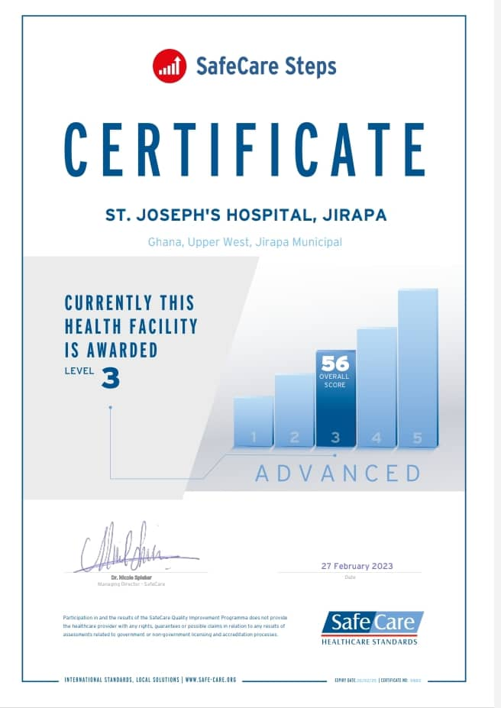
SAFECARE UPDATE
YEAR 2022
YEAR 2023

Slide 26
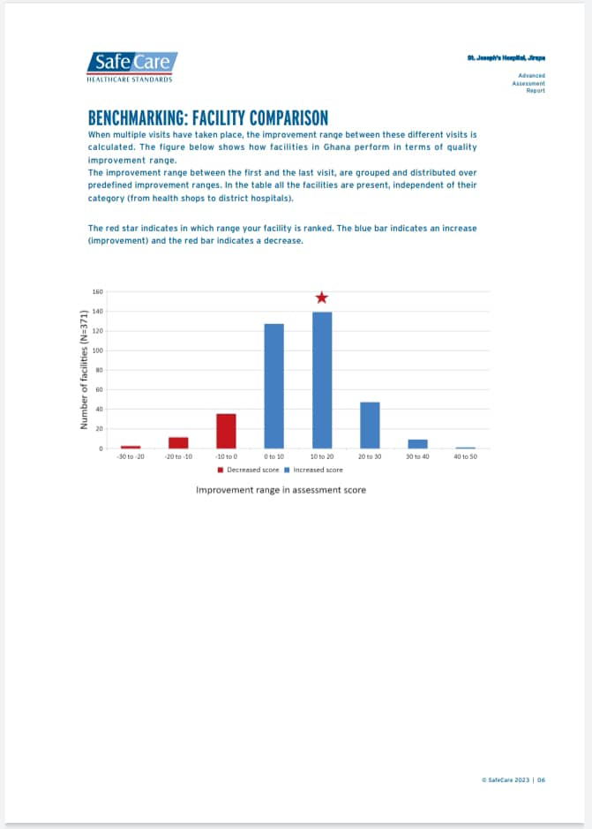
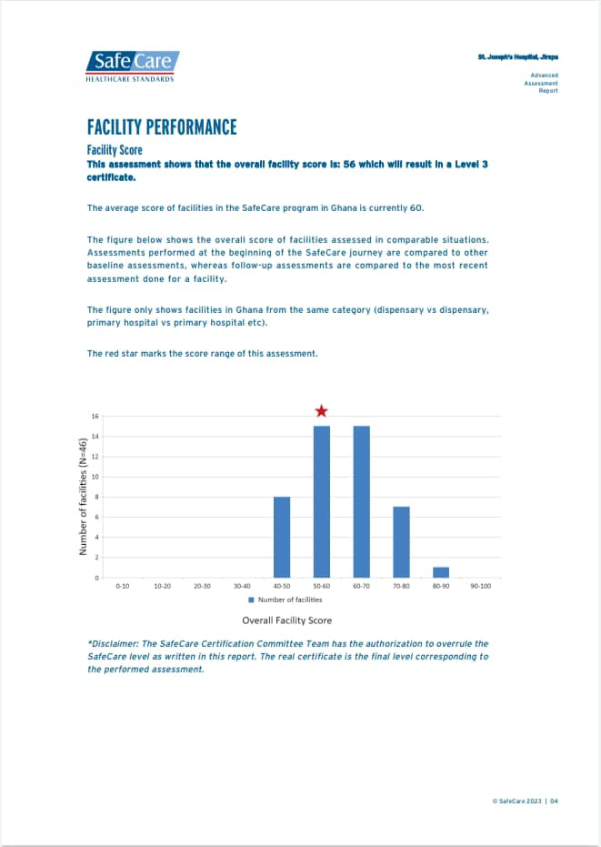

Slide 27
CHALLENGES - 1
Financial challenges
  Delay in NHIS reimbursement
  Low IGF generation
  Increasing cost of supplies and unfavourable payment terms
Infrastructural challenges
  Uncompleted Administration block
  Lack of accommodation for critical staff
  Limited space at NICU, labour ward and mortuary
  Proposed theatre at Maternity (not yet done)
  Uncompleted road and gutter construction

Slide 28
CHALLENGES - 2
Human resource challenges
  Absence of specialists eg. Paediatrician, Obstetrician/Gynaecologist, Neonatologist, Surgeon, Peri-operative nurses
  Staff attrition (study leave, seeking greener pastures etc)
  Increased number of casuals and payroll issues
  Staff filing/records limitations
Other challenges
  Lack of modern medical equipment
  Delays and inconsistencies in logistic supplies
  Poor equipment maintenance culture and wastage

Slide 29
ACHIEVEMENTS
German Urologists visit
Nsawam Physiotherapist outreach
Thrice weekly radio health talks
Phase I electronic health records system completed
End of year staff awards
Appointment with Minister of health
Specialty units community outreach program
Casual staff 20% monthly salary increment
Augmentation of laboratory staffing
Inception of inpatient breakfast services
Safecare promotion (from level 2 to level 3)
Arrival of new Medical Officer and Pharmacist
Inception of MHA addiction training program for rehab
Improvement in quantity of medical equipment

Slide 30
WAY FORWARD - 1
Provision of laboratory annex
Construction of oxygen plant and medical gas pipeline system
Collaboration with Zipline Ghana for drone supply of blood, blood products and emergency drugs.
Implementation of hospital accommodation policy
Procurement of Hb electrophoresis and Coagulation machines for laboratory
Estate developer contract for staff accommodation (BOT)
Continue lobby with Regional minister, MOH, MCE & MP to complete new administration block, hospital road and gutter construction
To transition from folder to paperless system - LHIMS

Slide 31
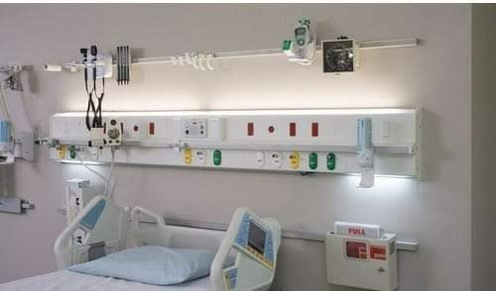
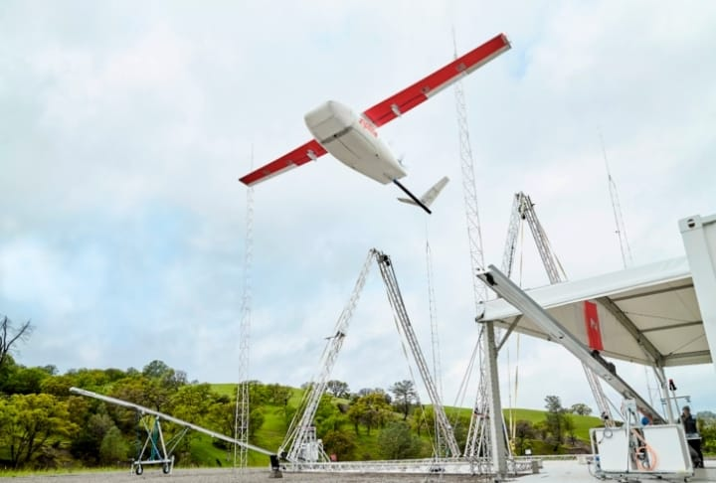
MEDICAL GAS PIPELINE SYSTEM
ZIPLINE GHANA

Slide 32
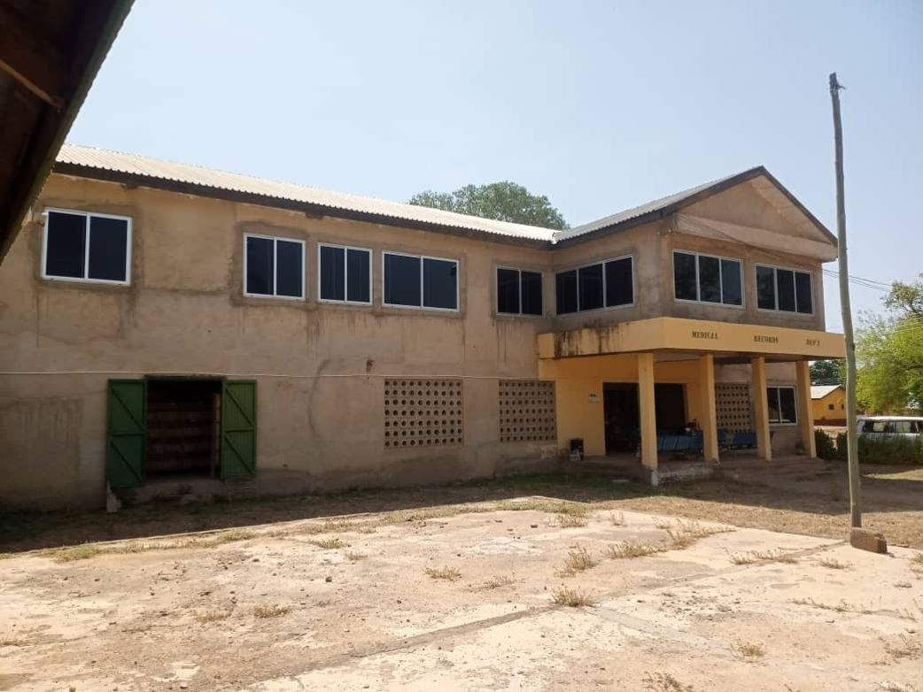
UNCOMPLETED NEW ADMINISTRATION BLOCK

Slide 33
WAY FORWARD - 2
Input of casual staff into controller payroll
Conversion of current conference room at maternity into Obstetrics and Gynaecology theatre
Creation of hospital website
Outsourcing of hospital canteen
Provision of sheds for patient relatives
Extension of CCTV cameras to stores
Acquisition of modern medical equipment
Engage philanthropists and organizations for support (Project C.U.R.E, JICA)

Slide 34
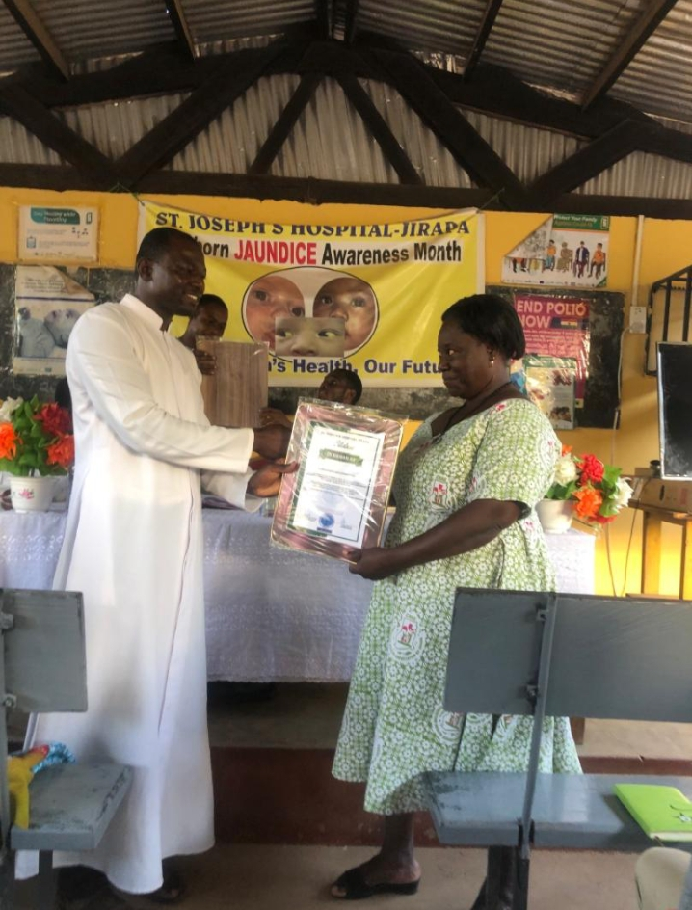

END OF YEAR STAFF AWARDS 2022
BEST LONG SERVING STAFF
BEST ADMINISTRATIVE STAFF – JUNIOR CATEGORY

Slide 35


END OF YEAR STAFF AWARDS 2022
OVERALL BEST STAFF
BEST DEPARTMENT

Slide 36

APPOINTMENT WITH MINISTER OF HEALTH

Slide 37
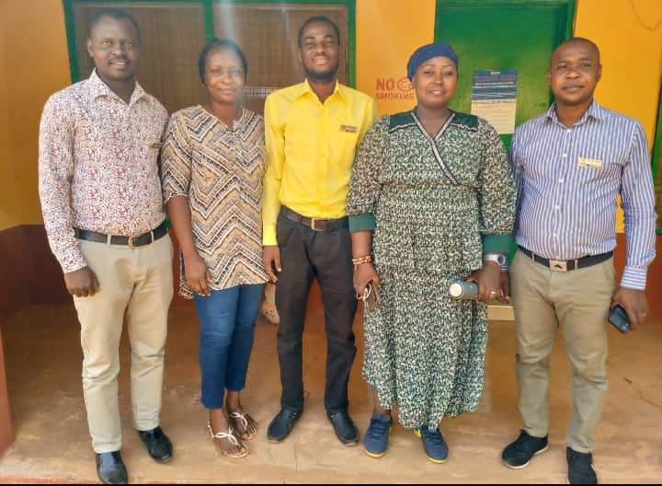
MENTAL HEALTH AUTHORITY – REHAB AND ADDICTION TRAINING PROGRAM

Slide 38
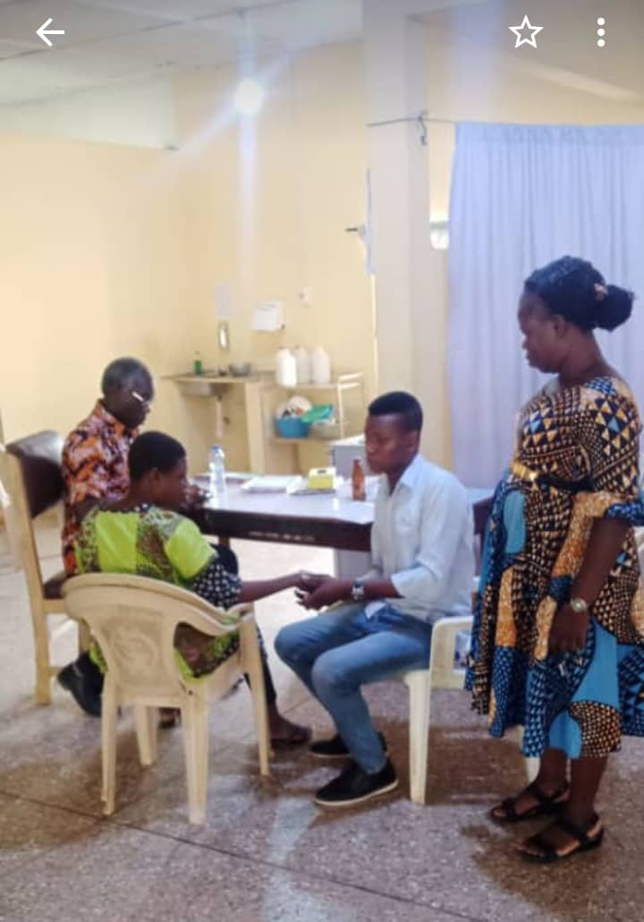
NSAWAM PHYSIOTHERAPISTS OUTREACH

Slide 39
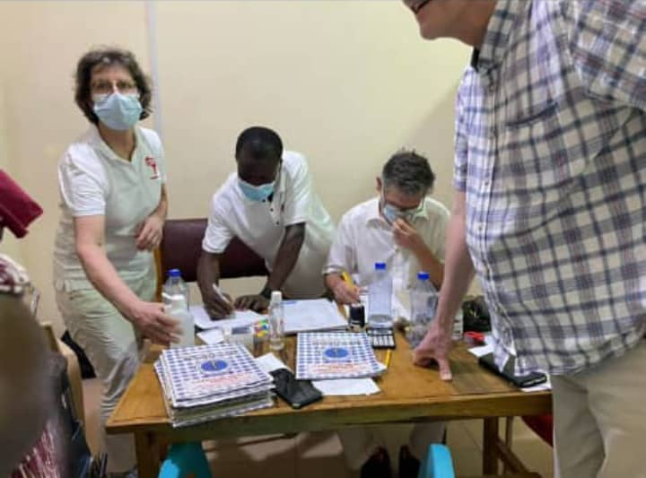
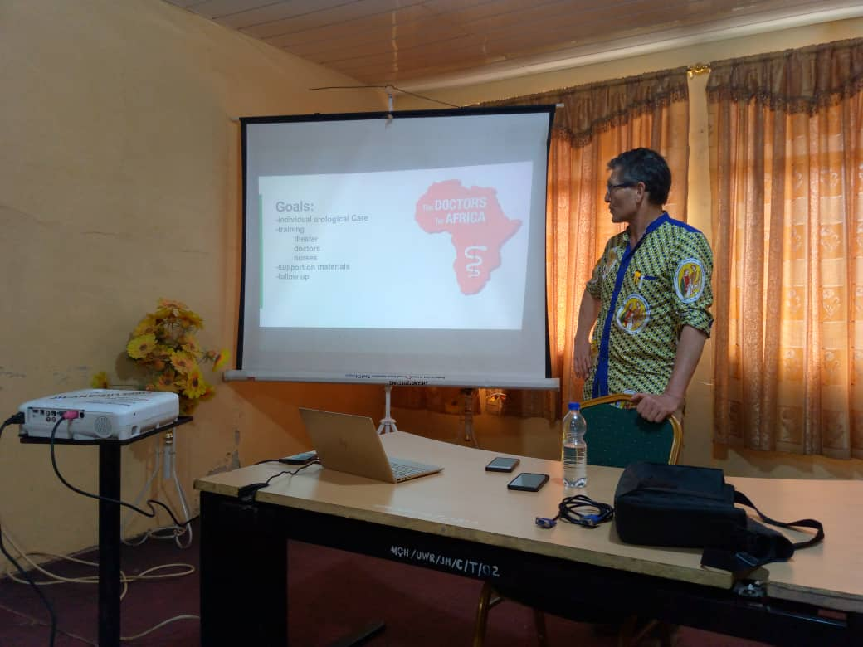
GERMAN UROLOGISTS VISIT

Slide 40
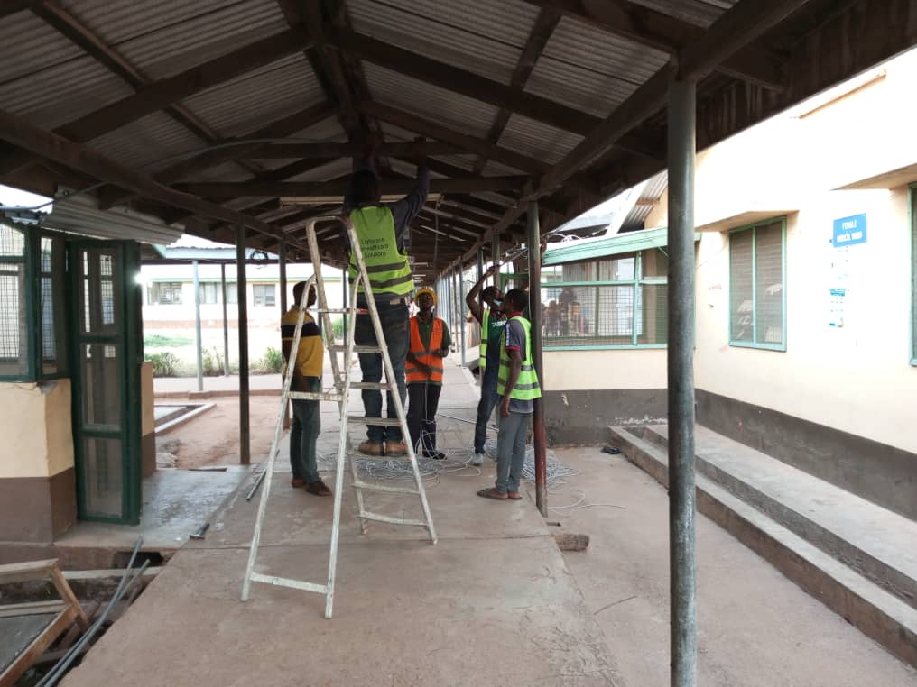
PHASE I OF ELECTRONIC HEALTH RECORDS SYSTEM - LHIMS

Slide 41
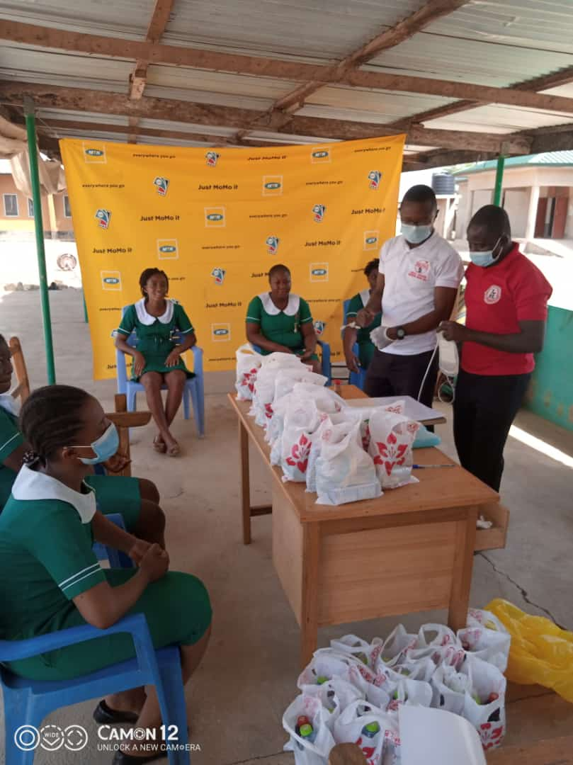
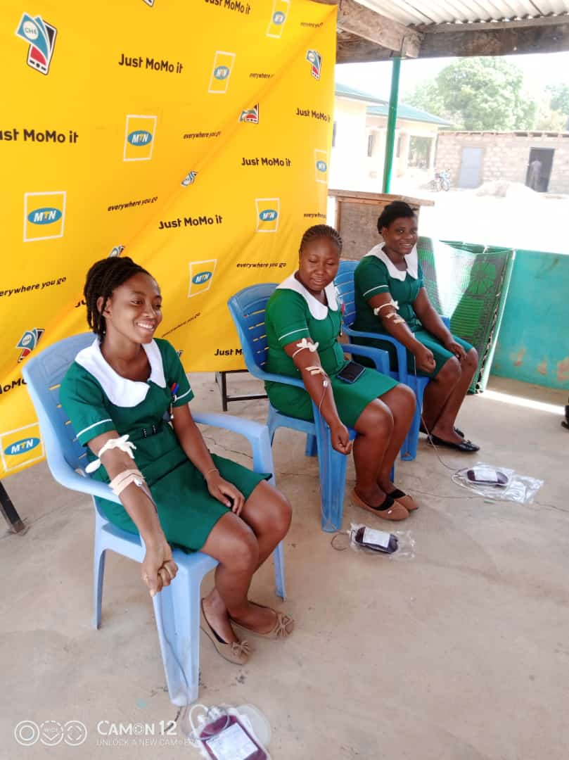
FIRST QUARTER BLOOD DONATION EXERCISE

Slide 42
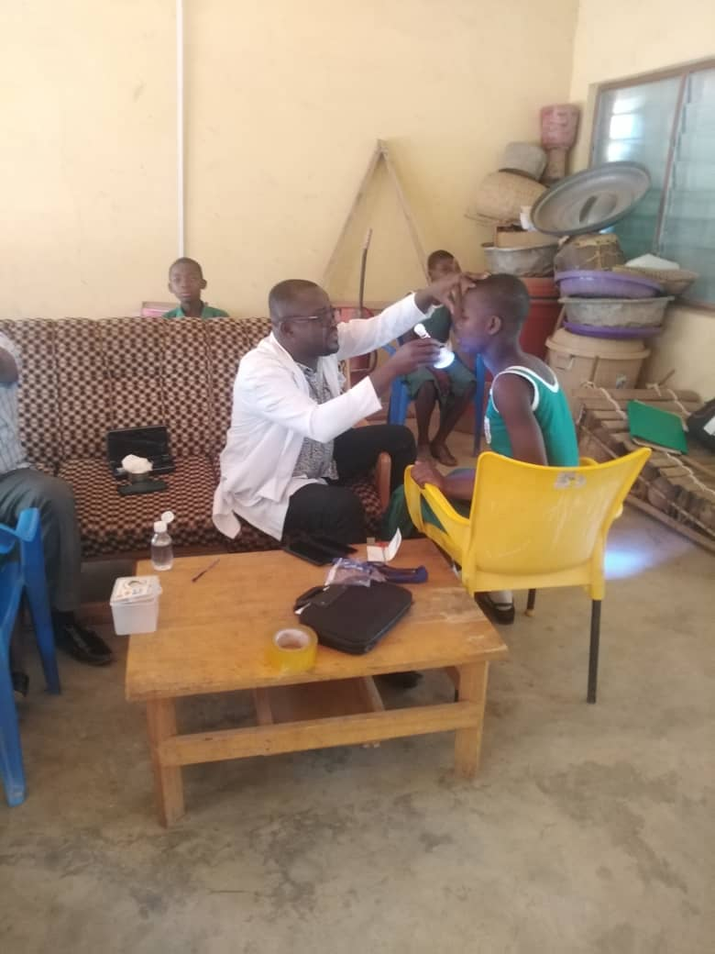
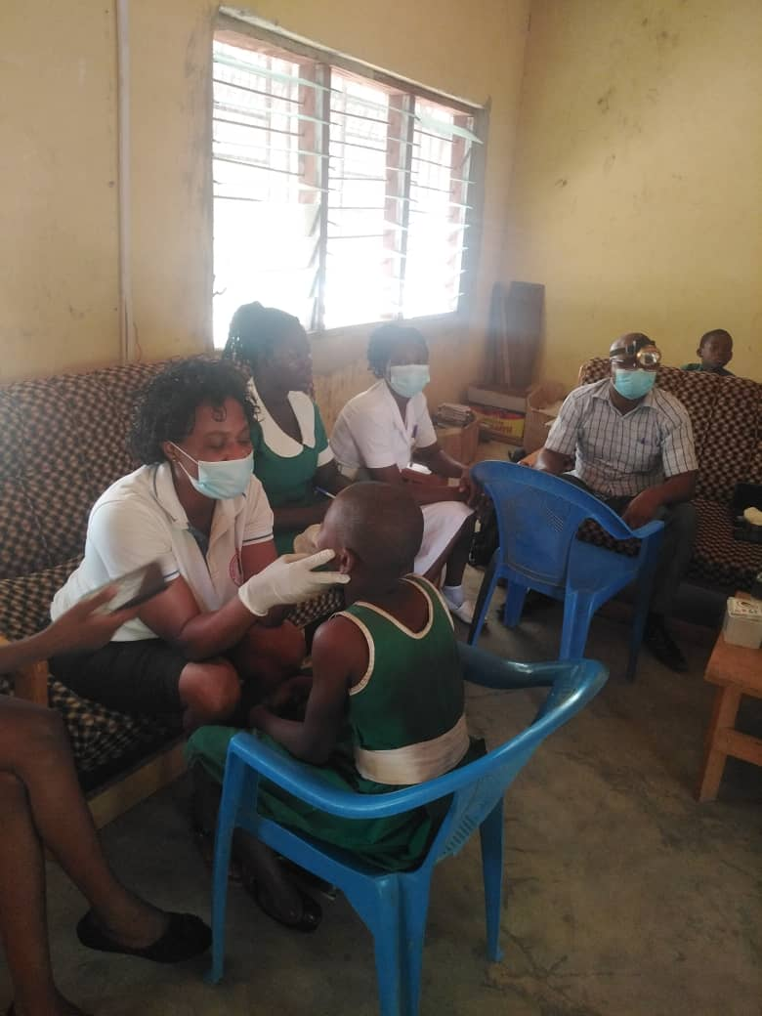
SPECIALTY UNITS COMMUNITY OUTREACH

Slide 43
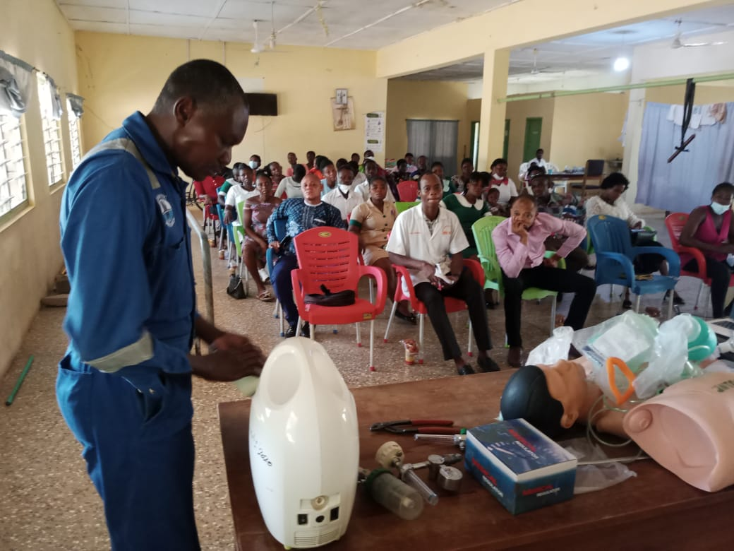
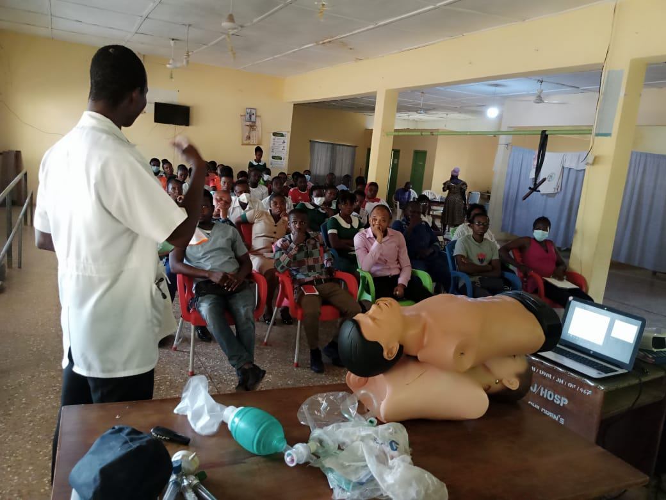
IN-SERVICE TRAINING

Slide 44
BAREKA!!!

